Slide 1
Construction in Word Vectors:
jia X zhen Y as example
Tan, Lian-Hui
https://shorturl.gg/Pgali0m

Slide 2
Table of contents
01
02
03
04
05
06
Introduction
Data Collection
Code
Discussion
Results
References

Slide 3
01
Introduction

Slide 4
Constructions in the lens of word vectors
Constructions are stored pairings of form and meanings that are partially filled and have full linguistic patterns (Goldberg, 2003).
The construction jia X zhen Y has been popular in news and Internet forums.
Desagulier (2015) uses l’analyse collexémique covariante, a quantitative approach of word distributions in English construction <ADJ as GN>.
This paper adopts a similar approach to that of Desagulier (2015), but differs in:
language: Chinese construction jia X zhen Y
model: fastText (Bojanowski, 2017; Joulin, 2016a, 2016b) to vectorize word senses
Notes:
構式是形式和意義的配對，構成成分不能預測整個構式的意義。構式包含空格，可以放詞進去，所以具有創造性。
假抱怨真炫耀
ADJ as GN such as “white as snow”, “cool as a cucumber.”

Slide 5
02
Data Collection

Slide 6
Data sentence
Copy data sentences from Chinese Word Sketch Engine (CWS) to a spreadsheet.
Manually filter out unqualified sentences.
fixated four-word expression, e.g. 假戲真做.
used in a different sense, e.g. 假盜領之名真詐財.
X and Y are the same, e.g. 投入假選票帶出真選票.
X and Y are two arguments of an event, e.g. 把假酒裝入真酒瓶.
*similar structures are included, e.g. 講緩和是假搞台獨是真.
Manually determine what the construction slots X and Y are, and collect into new columns.
Upload onto Google Colab.
Notes:
"是"作賓語提前

Slide 7
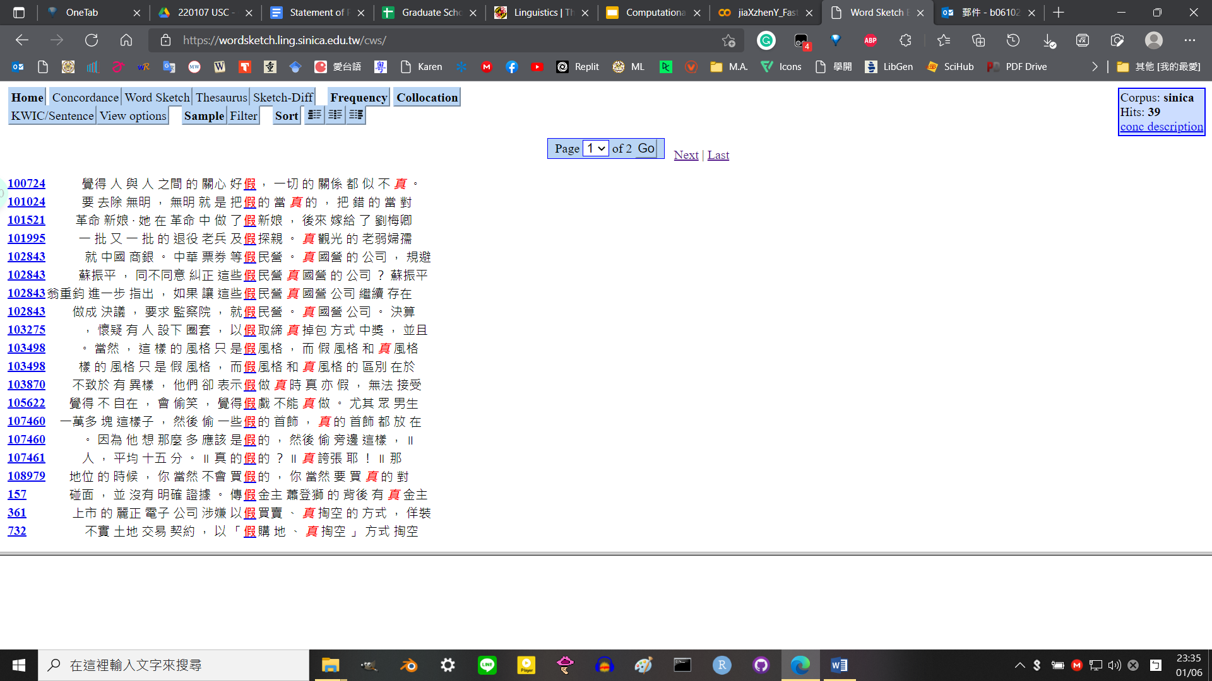
Figure 1
Example query of Chinese Word Sketch Engine

Slide 8
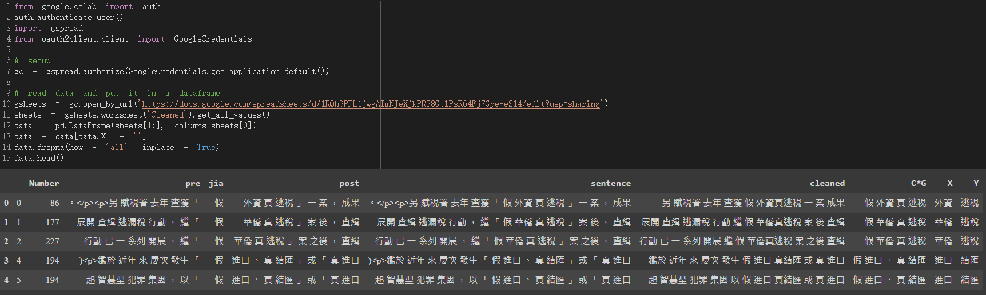
Figure 2
Data sentences in Google Colab for further process
Notes:
前半部分是從CWS複製貼上的時候作分隔才變成這麼多欄的

Slide 9
03
Code

Slide 10
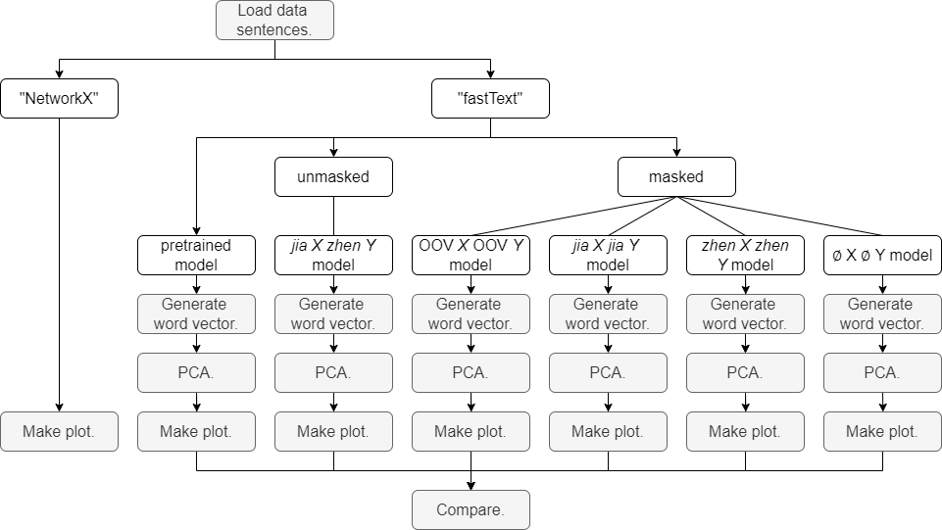
Figure 3
Code structure

Slide 11
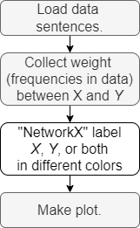
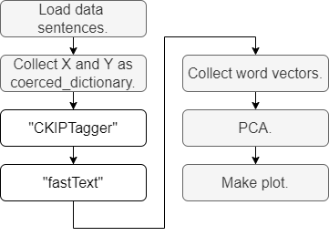
Figure 4
NetworkX process
Figure 5
fastText process

Slide 12
04
Results

Slide 13
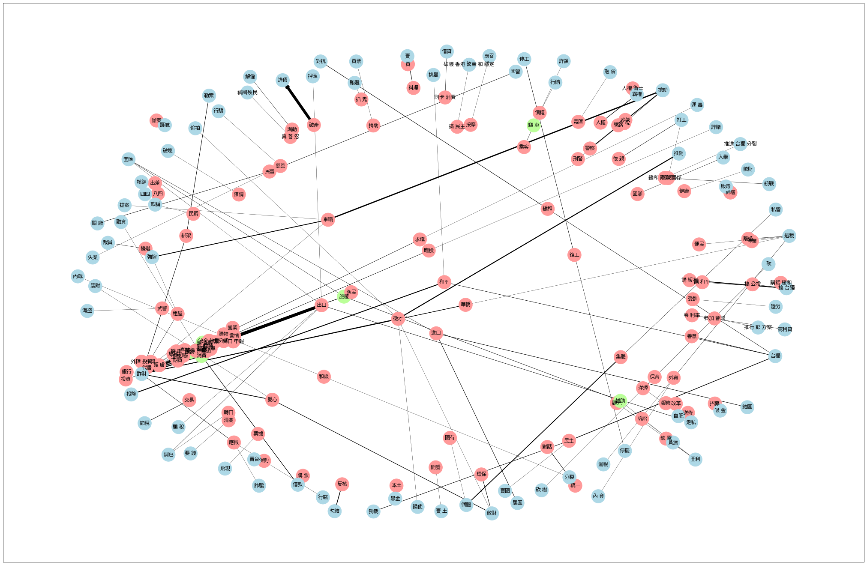
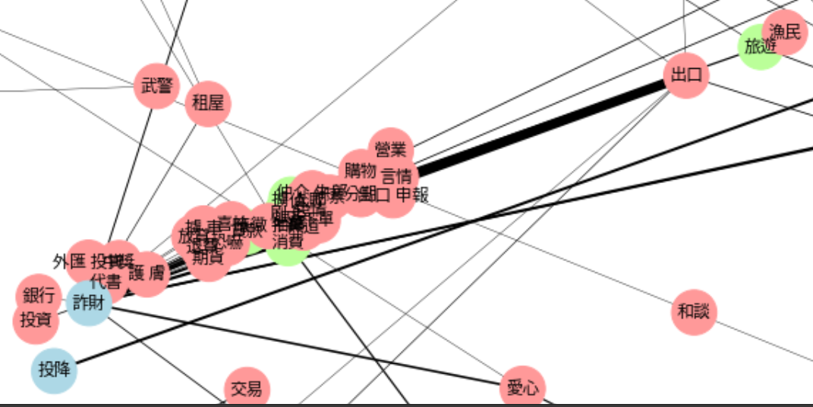
NetworkX
Figure 6
Networkx plot

Slide 14
NetworkX
Interpretations:
Multiple-to-one relationships occur in X-Y pairs, showing that more diversity in X. This is probably because Ys acknowledged the event, which, due to the nature of the corpus, are usually crimes on the news.
Some node connections are islands: only one instance in the data.
Most nodes do not connect with other nodes: Xs and Ys have their own niche.
Problems:
Nodes stuck together hinder further interpretations.
No explanations for inner and outer circle separation: Why are Xs in the center when they are the majority (330 > 279)?
Notes:
Some instances of X are 愛心、求職、貸款、期貨 when the Y is 詐財.

Slide 15
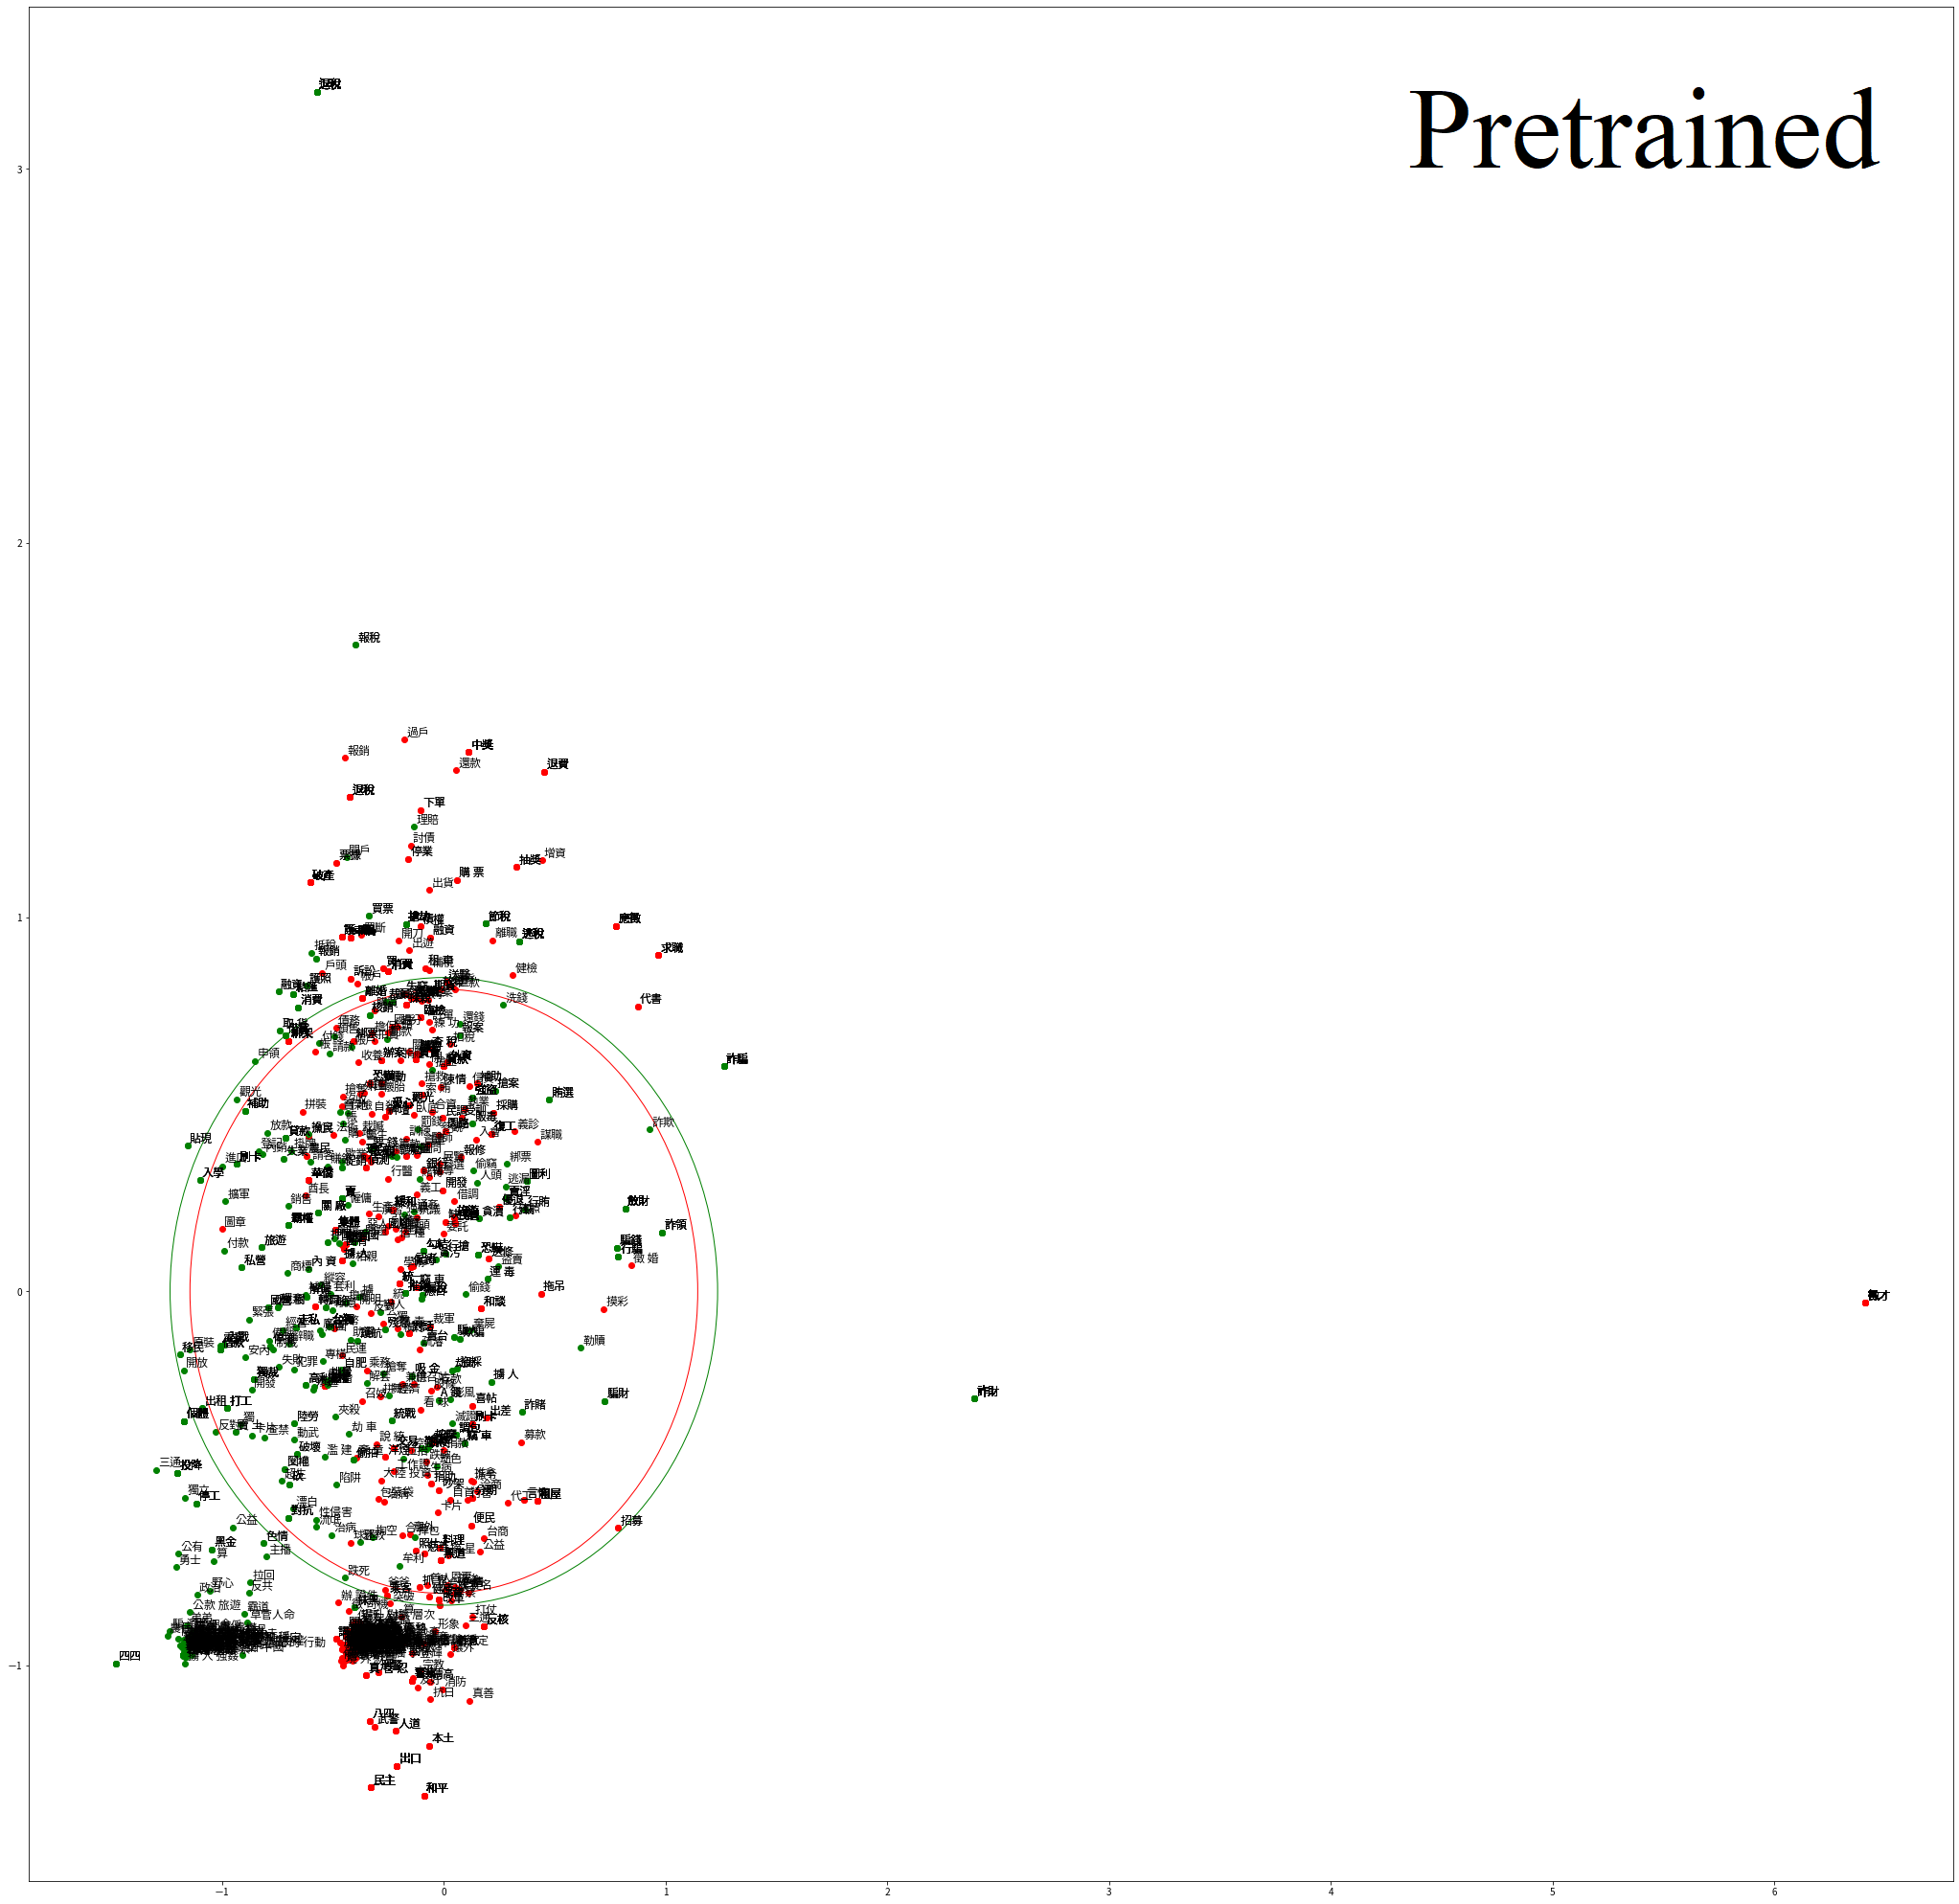
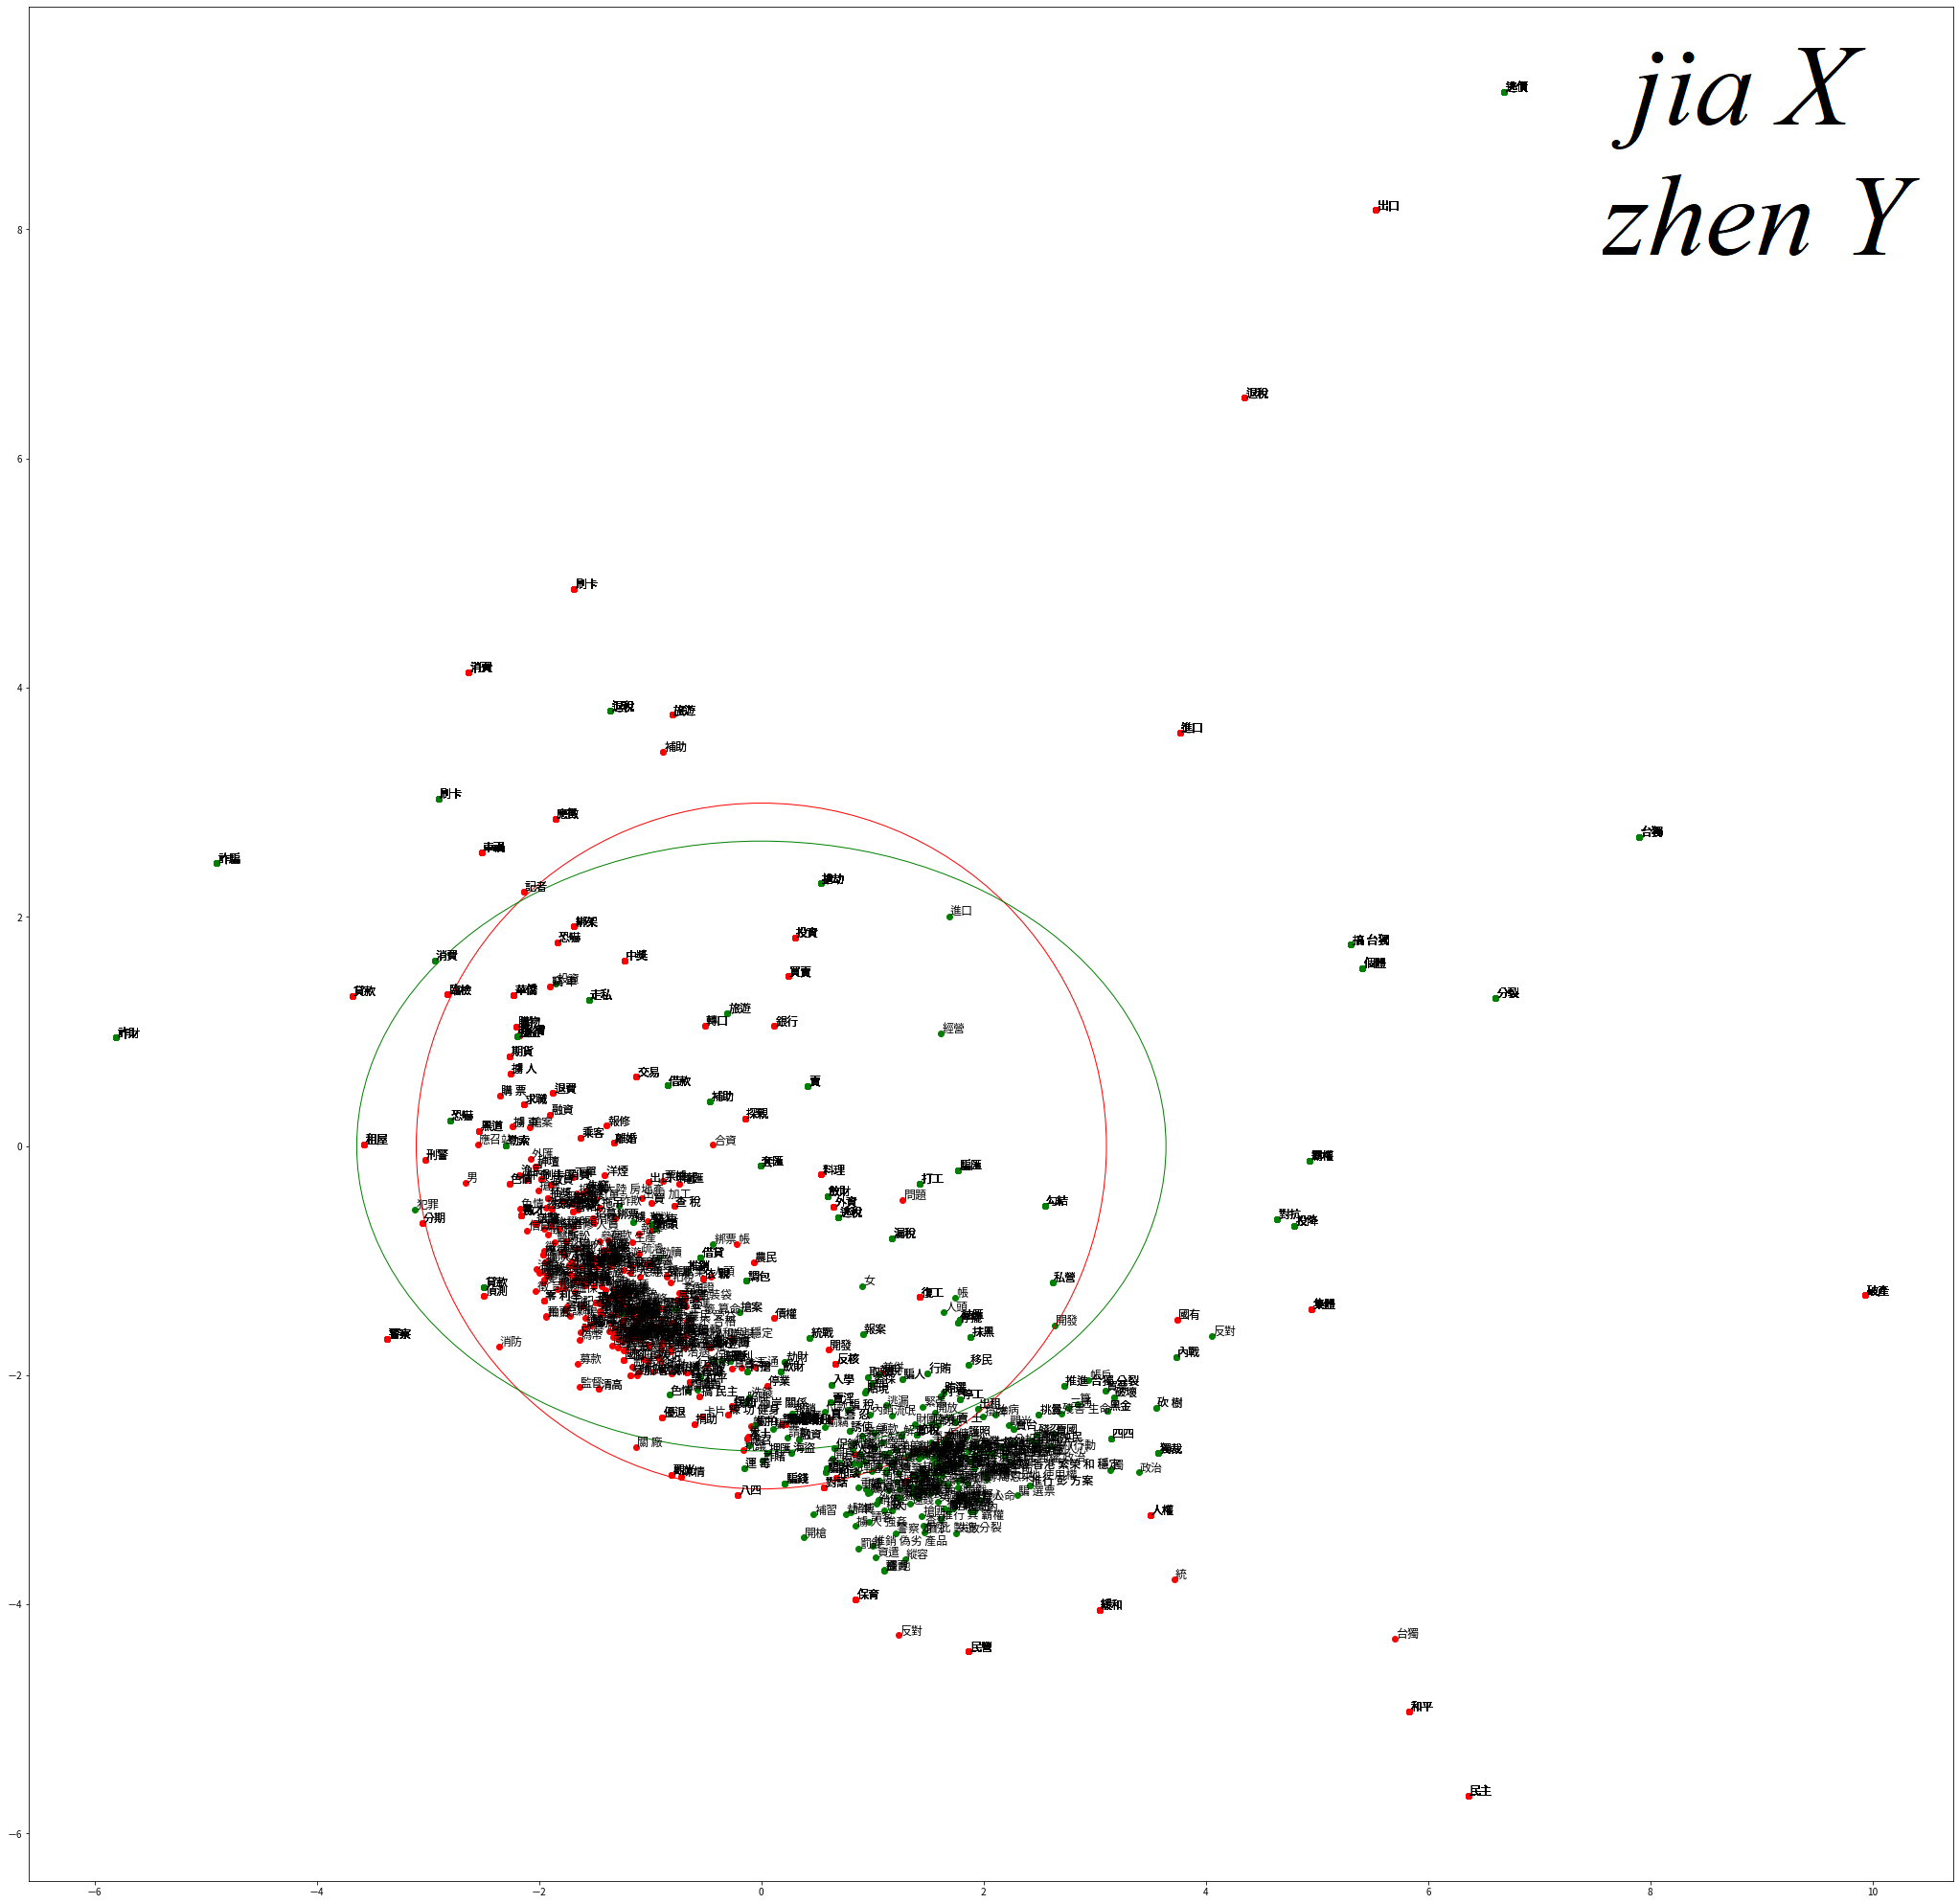
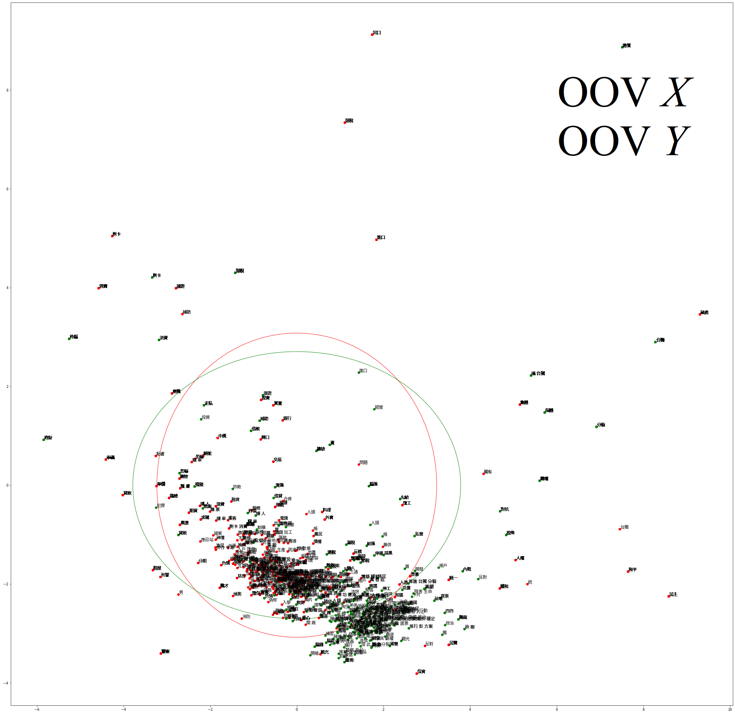
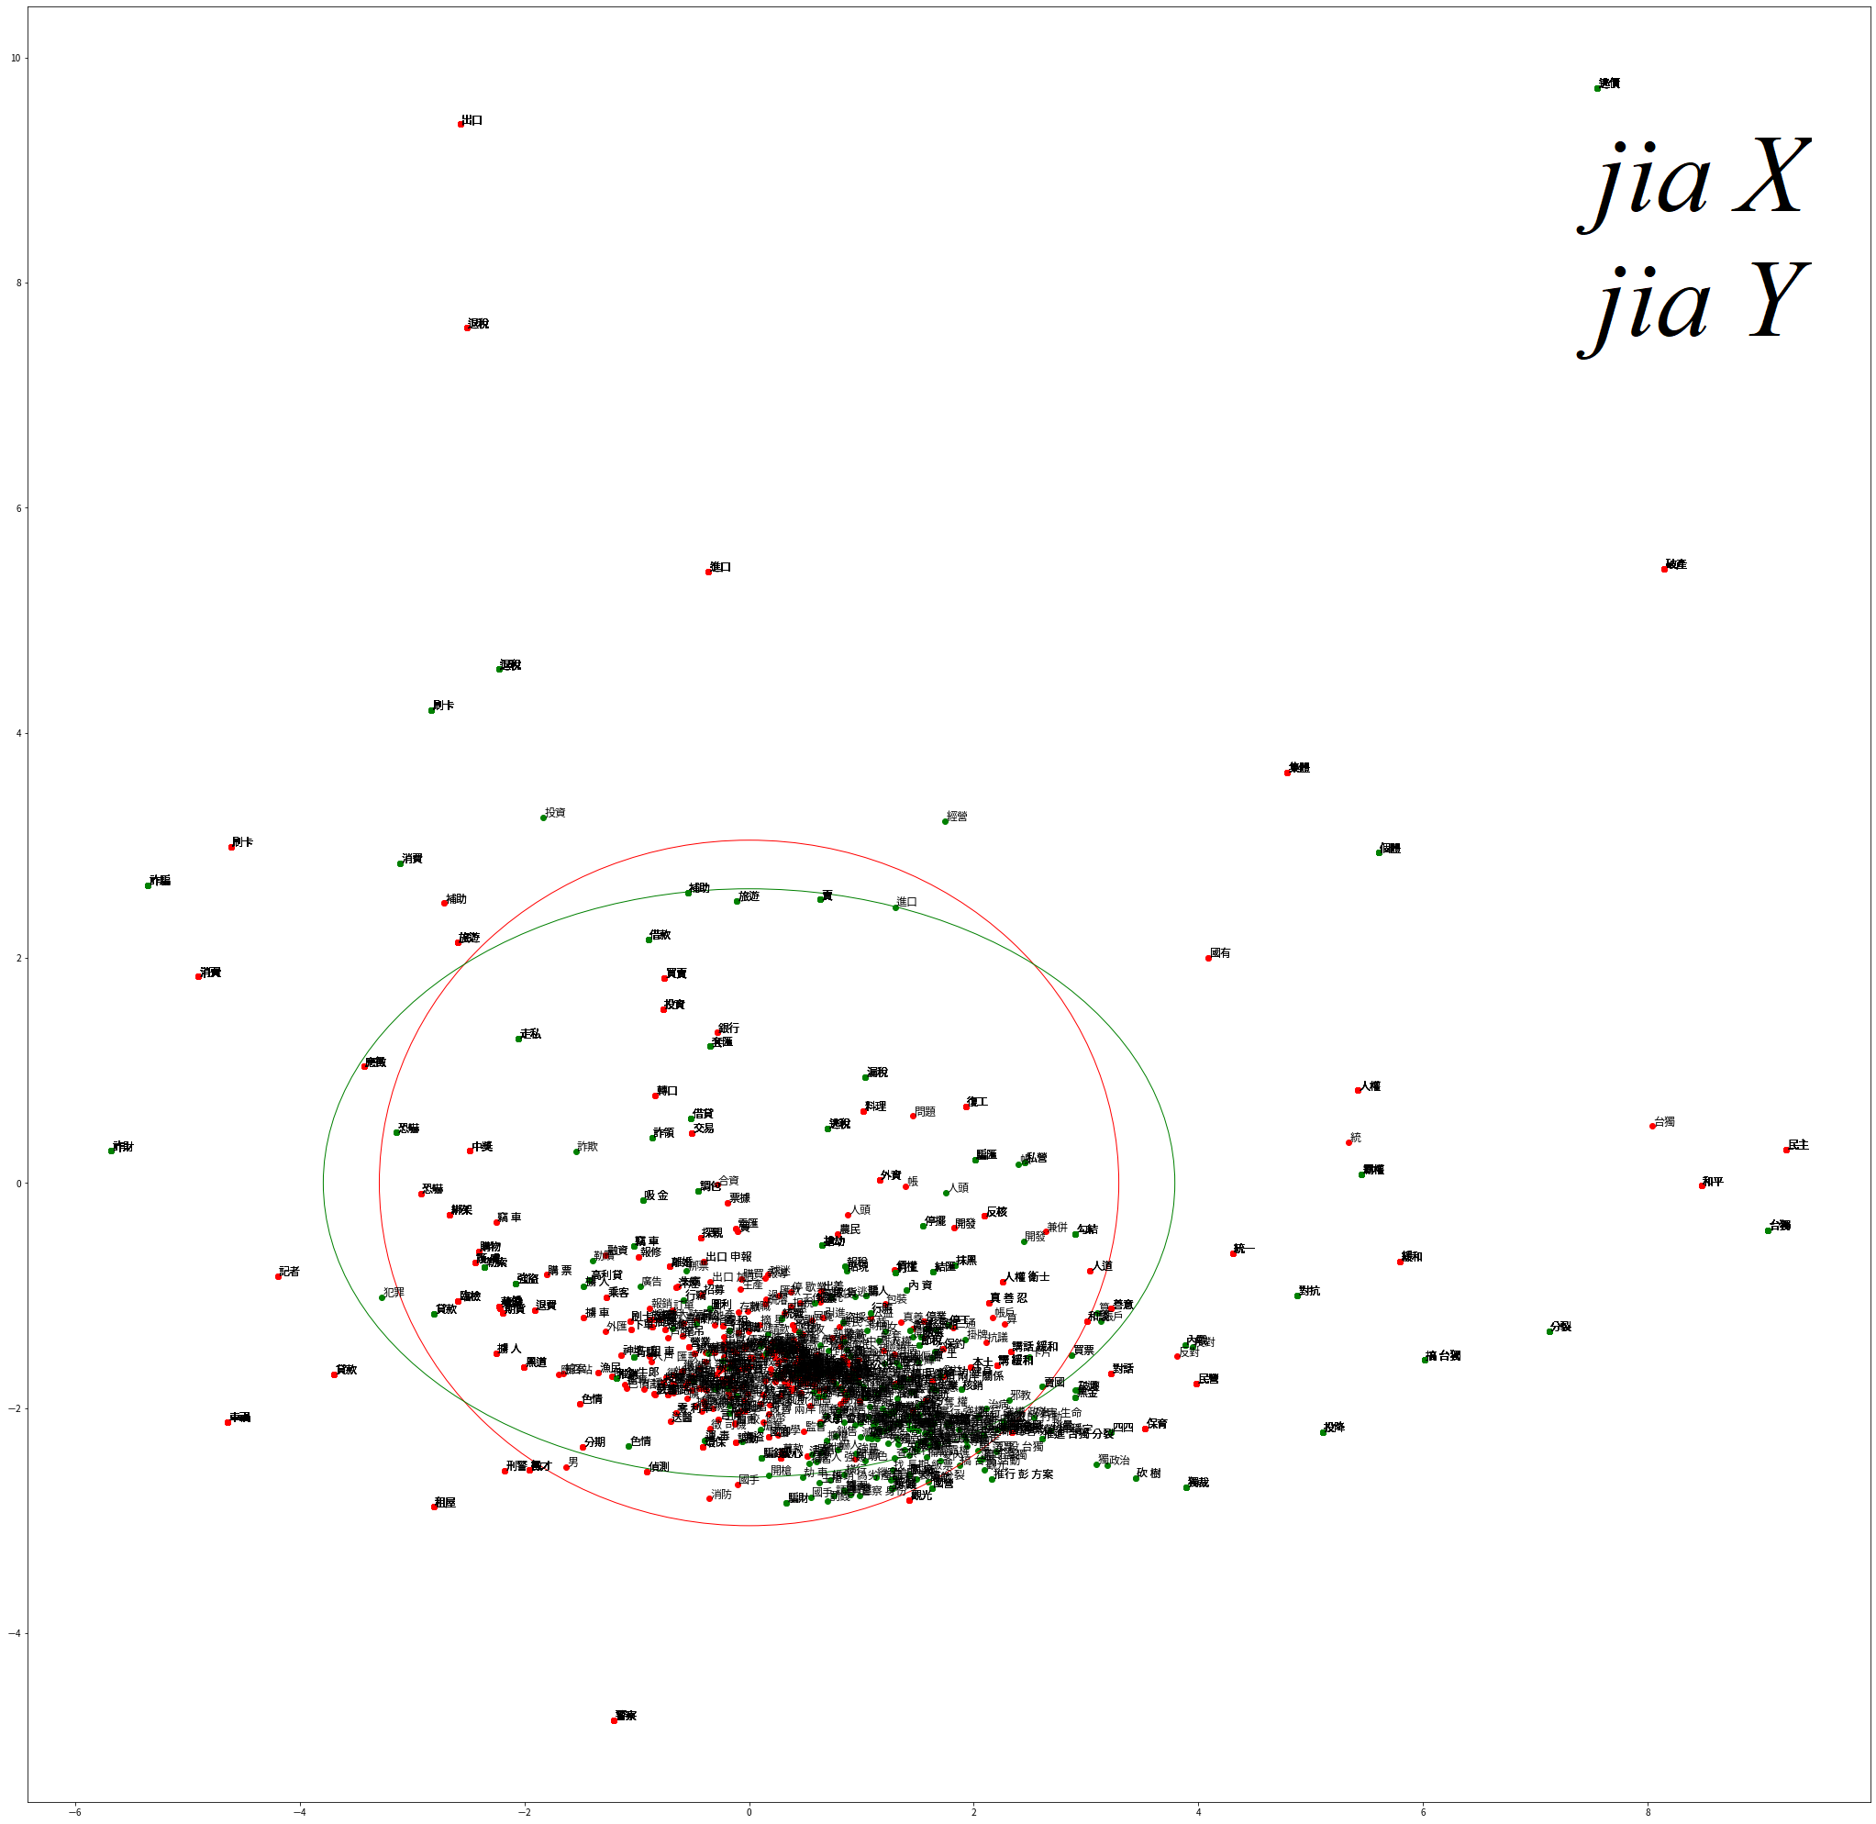
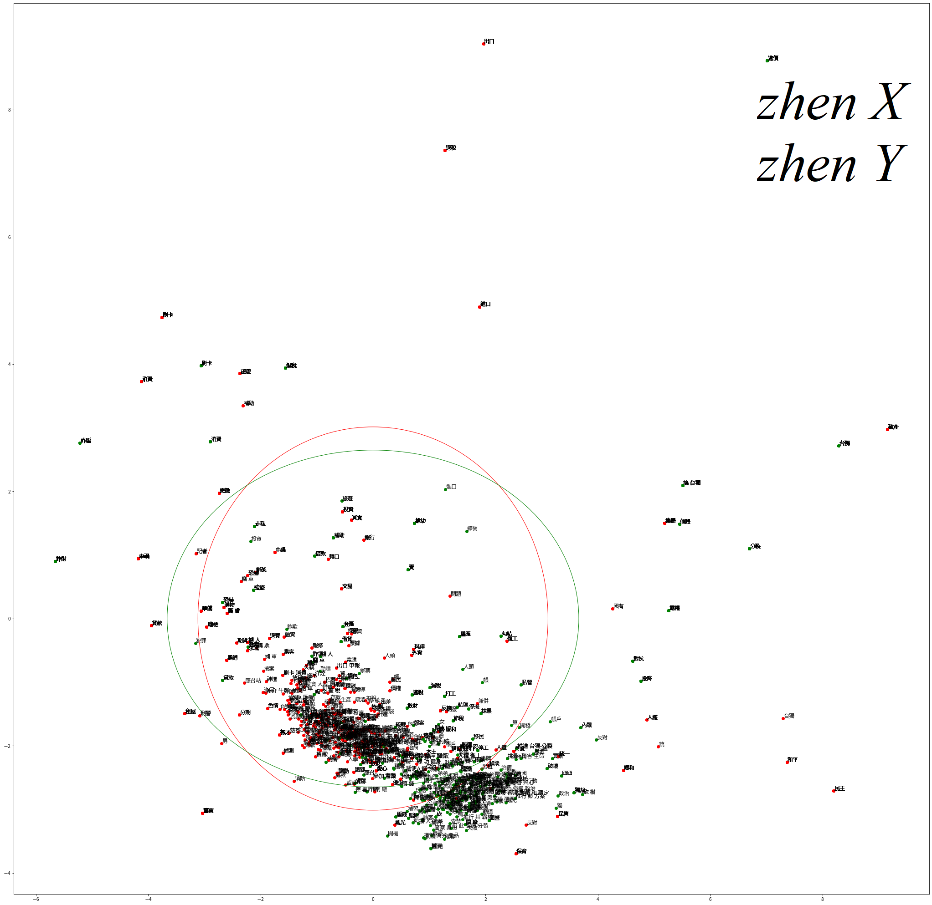
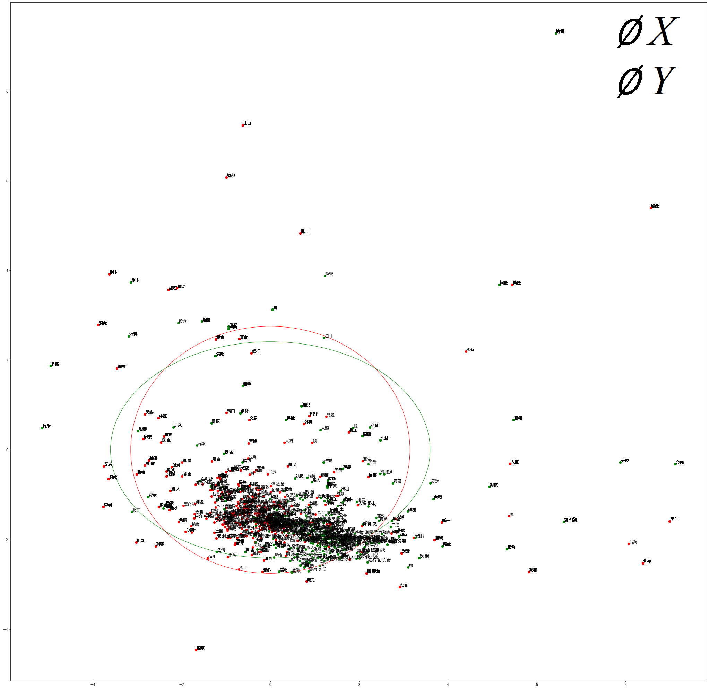
fastText word vectors
Figure 7
Comparison between word vectors of different models

Slide 16

fastText word vectors
Figure 8
Word vector distributions of
different model alternating
Interpretations:
As the ellipses have shown, there are not much difference between Xs and Ys in word vector representations.
Masked and unmasked models are not much different, showing that the distributions are not influenced by the recurrence of jia and zhen.
Problems:
No suitable way to compare between pre-trained models and the other models.

Slide 17
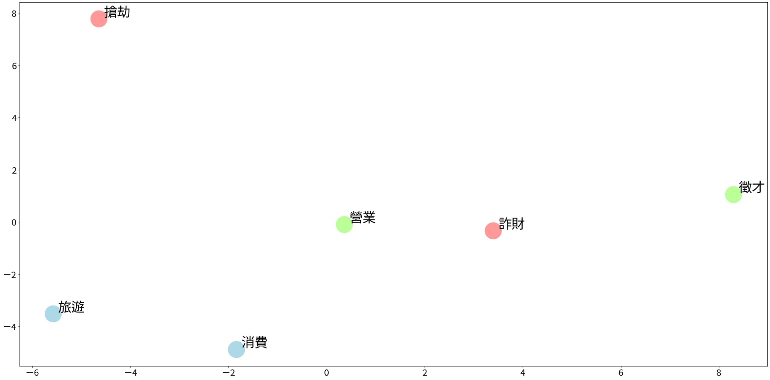
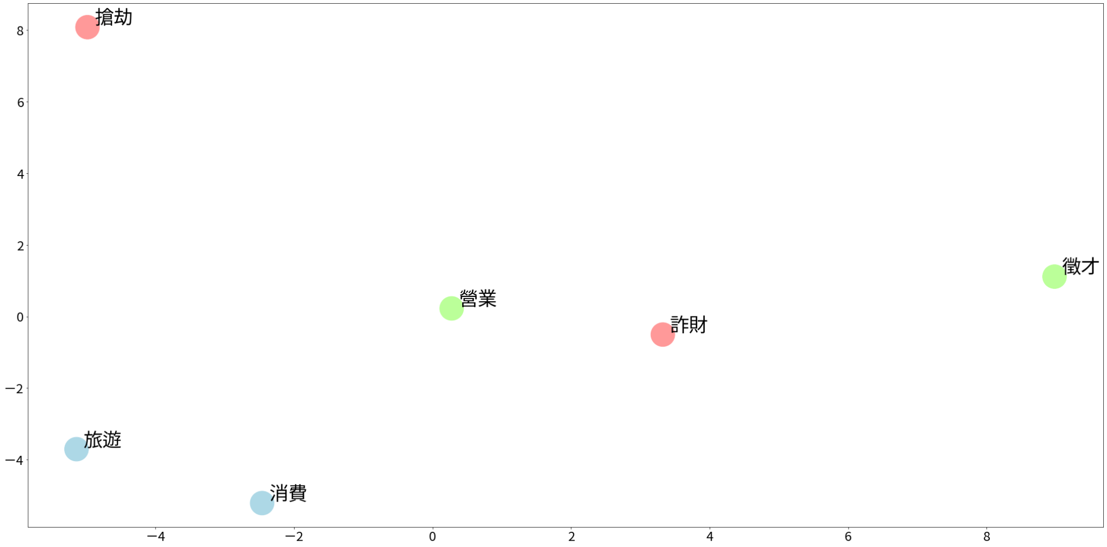
Comparing masked and unmasked models
Figure 9
Comparison between jia X zhen Y vs. OOV X OOV Y using representative words
Selecting representative words appearing in X, Y or both slots. Patterns are similar in jia X jia Y and zhen X zhen Y, and ∅ X ∅ Y. Also not much different between masked and unmasked models.
Notes:
red X green Y
blue both: 假消費真申領、假刷卡真消費、假旅遊真套匯、假漁民真旅遊

Slide 18
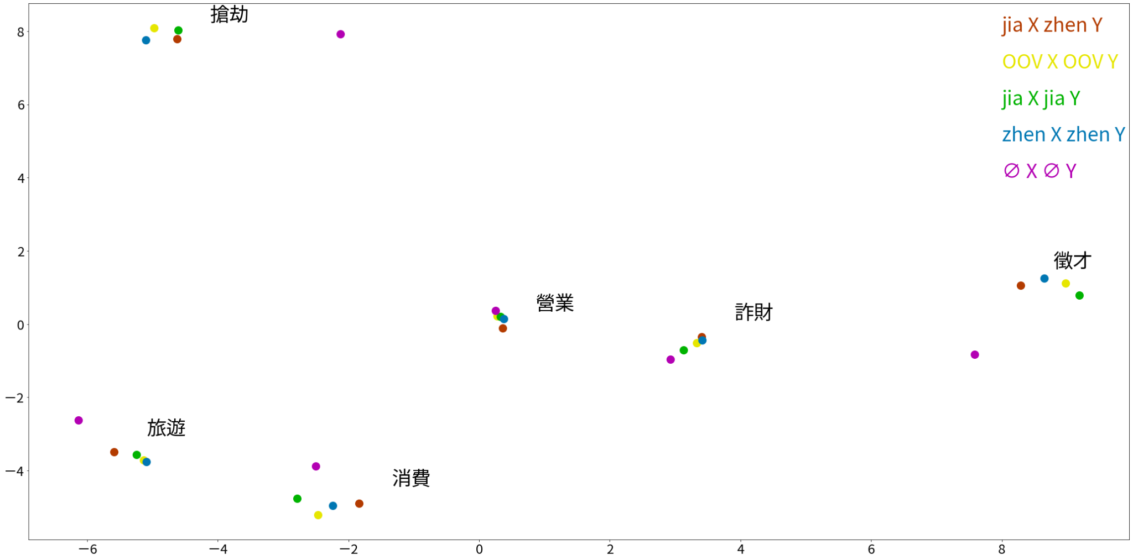
Comparing masked and unmasked models
Figure 10
Comparison between all models using representative words

Slide 19
05
Discussion

Slide 20
Certain pattern exists.
Node diagram
There are more diverse words in X than in Y, but might be influenced by the nature of data.
Word vector representation
Jia and zhen select words that have unique distributions of word vectors.
might be the effect of news article style
Future research:
diachronic changes of the relations between X and Y
Gather data from more corpus and compare word representations among corpus.

Slide 21
Limitations
Data sentence are limited by only collecting from Chinese Word Sketch Engine, which is mostly comprised of news. Collecting data sentences from other colloquial corpus such as PTT Forum would be great.
NetworkX model too complicated to interpret easily. Could use synonymy to group similar words into collective nodes.
Word vector representations of X and Y are hard to visualize aesthetically. Any suggestions?
Part of speech, sentiment, and phrase length may be altering the word vector representations and should be controlled.
Notes:
更多資料、美化圖片、詞性+情緒+詞/句可能影響向量分布。

Slide 22
06 References
Bojanowski, P., Grave, E., Joulin, A., & Mikolov, T. (2017). Enriching word vectors with subword information. Transactions of the Association for Computational Linguistics, 5, 135-146.
Desagulier, G. (2015). Le statut de la fréquence dans les grammaires de constructions: simple comme bonjour?. Langages, (1), 99-128.
Goldberg, A. E. (1995). Constructions: A construction grammar approach to argument structure. Chicago: Univ. of Chicago Press.
Huang C.-R., Smith S., Ma W.-Y., & ŠImon P. (2005). Academia Sinica Center for Digital Cultures. Chinese Word Sketch Engine. Retrieved December 21, 2021, from https://wordsketch.ling.sinica.edu.tw/cws/
Joulin, A., Grave, E., Bojanowski, P., Douze, M., Jégou, H., & Mikolov, T. (2016a). Fasttext. zip: Compressing text classification models. arXiv preprint arXiv:1612.03651.
Joulin, A., Grave, E., Bojanowski, P., & Mikolov, T. (2016b). Bag of tricks for efficient text classification. arXiv preprint arXiv:1607.01759.
Liu F., Luo Q. (2020). Gradability, Subjectivity and the Semantics of the Adjectival zhen ‘real’ and jia ‘fake’ in Mandarin. In: Hong JF., Zhang Y., Liu P. (eds) Chinese Lexical Semantics. CLSW 2019. Lecture Notes in Computer Science, vol 11831. Springer, Cham. https://doi.org/10.1007/978-3-030-38189-9_17
Rambelli, G., Chersoni, E., Blache, P., Huang, C. R., & Lenci, A. (2019, August). Distributional semantics meets construction grammar. towards a unified usage-based model of grammar and meaning. In First International Workshop on Designing Meaning Representations (DMR 2019).

Slide 23
Thank you for listening
Any questions?
Please keep this slide for attribution

Slide 24


